Slide 1
Disease Prognosis Expert System
Group 4:
Vaibhav Jain (100837042)
Smirit Raina (100830255)
Vaibhavi Thakkar (100833169)
Shuritka Raut (100844617)

Slide 2
Introduction
Advancement in the medical field has helped both doctor and patient to fight against many severe diseases. However, there are many real time cases where though providing symptoms patients need to wait for a report and to overcome this, the provided Expert System will help to detect diagnosis based on symptoms provided.
Task and Purpose of the Expert System
The purpose of this expert system is to support the diagnosis process of physicians. It considers facts and symptoms to provide diagnosis. This is a Rule Based Expert System that helps the user to detect which disease they have by analyzing their provided symptoms. In this system we have added a couple of diseases to analyze.

Slide 3
Technology Stack
Repository | Github
Programming Language | Python
IDE | PyCharm, Anaconda, Visual Studio
Data | Text File
Featured Library | Experta

Slide 4
Knowledge Sources & Knowledge Acquisition
The system is designed based on the data of various diseases, its symptoms, and treatments. Nearly 15 diseases were analyzed for training and testing of the system. The data was segregated into separate text files containing disease details, symptoms and treatments and further mapped to each disease.
Source of Data:
https://www.webmd.com/a-to-z-guides/common-topics
https://www.mayoclinic.org/diseases-conditions

Slide 5
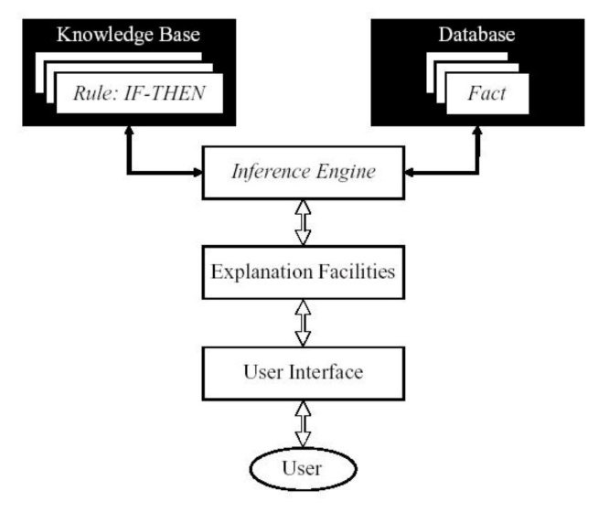
Knowledge Design & Engineering
The goal of designing an expert system is to solve a complex problem by reasoning with knowledge rather than by conventional procedural codes. The design of a system consists of consists user interface, data management layer (knowledge base) and application processing (inference engine).

Slide 6
System Components
User interface interacts to system user to get input data and to receive system generated output.
Data management layer includes designing the knowledge base containing the rules and facts about various diseases.
Application processing layer is concerned with input transformation, rule activation weight calculation, and the aggregation of the rules.

Slide 7
Inference Procedures
To diagnose the diseases, it is necessary to get its values of the signs and symptoms, collected from experts. These values considered as the input values of the expert system. Basically, these signs and symptoms considered as the antecedent attributes of a rule. Each input value needs to be distributed over the referential values of an antecedent attribute to demonstrate what amount of this input value match with each of the referential value. The referential values of each antecedent attribute may by “Severe”, “Mild” and “No”, which are similar to the signs and symptoms of the diseases as express by the experts in terms of these linguistic terms.
This factual knowledge is used to to derive logical conclusions. Here the system uses forward chaining to search from the rules until the rule is found where the if-clause is known to be true. When such a rule is found, the process may conclude or forward to the then-clause for further inference. The process is iterated until a goal is reached.

Slide 8
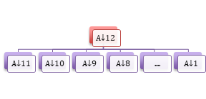
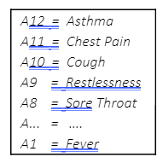
Knowledgebase Construction
Decision tree which has been developed using knowledge acquisition. The tree represents a multilevel hierarchical structure of the knowledge base. The leaf nodes become the antecedent attributes of a rule and the parent node becomes its consequent attribute.
This rule base consists of 11 antecedent attributes namely A1, A2, A3… A11.
Each attribute has three referential values, namely severe (S), mild (M) and
no symptoms (N). So, the belief rule is written as,
R1: IF Chest Pain is Severe AND Cough is Severe AND Restlessness is Mild AND …
THEN { Disease identified is Asthma }

Slide 9

DEMO

Slide 10

Thank You

